Slide 1
Children’s tales: the reality of Covid-19 related trauma on school children in rural Busoga, Uganda
Investigators:
R. Balikoowa, D. Ojiambo, G. Mwesigwa, R. Kayanga, J.F Kikooma, & M.M Baluku
Makerere University School of Psychology
Research Dissemination
1st February, 2021

Slide 2
Background
School children constitute about 34%
About 63% are in pre-primary and primary/elementary school
Busoga sub-region constitutes about 10% of the pre/primary
Schools were closed (in Uganda) on Mar 20, 2020 after WHO declaration Mar 11
No known child-focused relay of Covid-19 related information
Interventions (mainly) concentrated in urban centers
The advance of the novel corona virus outshone/dwarfed all other
(already) biting socioeconomic challenges
Notes:
to meet their obligation to support children with basic scholastic materials and meals at school

Slide 3
Purpose
To obtain first-hand information on the psychosocial impact of Covid-19 pandemic on school children in rural Busoga, through:
Exploring their lived experiences of Covid-19
Discovering their perception of the public health measures as regards the Covid-19 in their protection
Ascertaining their understanding of the media and general public information about Covid-19
Establishing if there is any association between Covid-19 preventive measures and their trauma.

Slide 4
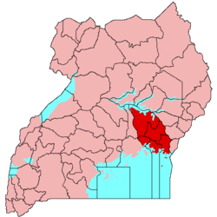
Methods
Cross-sectional mixed methods study between August and September 2020
Quantitative survey with 418 children
Qualitative interviews and focus groups with 36 children (from 11 to 15 years)
child-focused methodologies: picture drawings, focus group conversations, story circles and notes writing
Adult participants consented and children assented
BUSOGA
Notes:
Triangulation useful for cross validation and reliability
Qualitative and quantitative collected concurrently

Slide 5
Quantitative Variables
Adherence to Covid-19 preventive measures
Adherence inconvenience
Behaviour dysfunction
Trauma signs
Notes:
Children's Revised Impact of Event Scale (CRIES) Perrin, S., Meiser-Stedman, R., & Smith, P. (2005)

Slide 6
Results: Quantitative
Demographics (N=418)
 | Variable | Freq (n) | Percentage (%)
Sex | Female | 247 | 59.1
 | Male | 171 | 40.9
Class | P.5 |  | 40.4
 | P.6 | 80 | 32.8
 | P.7 | 109 | 26.8
 | P.5 | 11.2
Average age | P.6 | 12.83
 | P.7 | 13.98
Associations
 |  | Adherence Inconv. | Trauma | Behaviour Dysfunction
Adherence Rem | Pearson Correlation | .124* | .115* | .071
 | Sig. (2-tailed) | .011 | .018 | .147
 | N | 418 | 418 | 418
Adherence Inconv. | Pearson Correlation |  | .103* | -.094
 | Sig. (2-tailed) |  | .034 | .054
 | N |  | 418 | 418
Children Trauma | Pearson Correlation | 103* |  | .
 | Sig. (2-tailed) | .034
 | N | 418
Behaviour Dysfunction | Pearson Correlation |  | .193**
 | Sig. (2-tailed) |  | .000
 | N |  | 418
-124
.011
.115
.018
103
.034
..193
.000
Notes:
Quantitative results indicate that there is a significant positive correlation between parental and community involvement and children’s schooling (R=0.0303; R²=0.92; p=0.00<0.05);
Community involvement (β=0.303;β=0.276;p=0.001< 0.05) predicting children’s schooling more than their parental involvement (β=0.079; β=0.057; p=0.488>0.05).

Slide 7
Quantitative: Variable Effect
Behavioral Challenges Coefficientsª
Model |  | Unstandardized Coefficients | Sig.
 |  | B
1 | (Constant) | 27.143 | .000
 | Gender | .010 | .981
 | Age | .356 | .021
 | Class | .376 | .229
 | Adherence Remembrance | .102 | .286
 | Adherence Inconvenience | -.336 | .003
 | Children Trauma Checklist | .116 | .000
 | R² adjusted | .068
Children’s Trauma
Age & Class level
Coefficientsª
Model |  | Unstandardized Coefficients | Sig.
 |  | B
1 | (Constant) | 22.107 | .000
 | Gender | -.444 | .560
 | Age | .564 | .031
 | Class | -1.130 | .034
 | Adherence Remembrance | .387 | .017
 | Adherence Inconvinience | .408 | .036
 | R² adjusted | .027
Notes:
Quantitative results indicate that there is a significant positive correlation between parental and community involvement and children’s schooling (R=0.0303; R²=0.92; p=0.00<0.05);
Community involvement (β=0.303;β=0.276;p=0.001< 0.05) predicting children’s schooling more than their parental involvement (β=0.079; β=0.057; p=0.488>0.05).

Slide 8
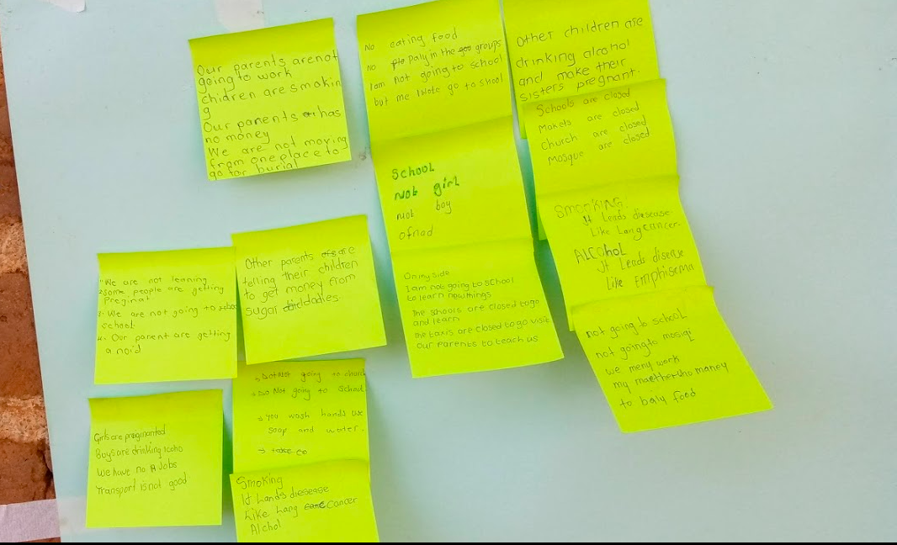
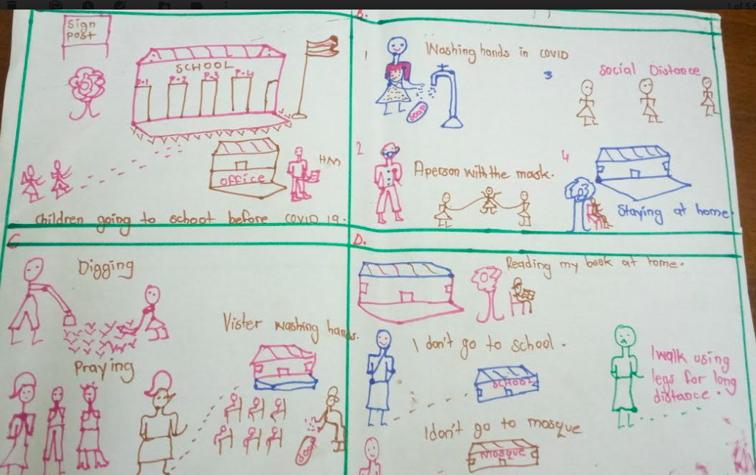
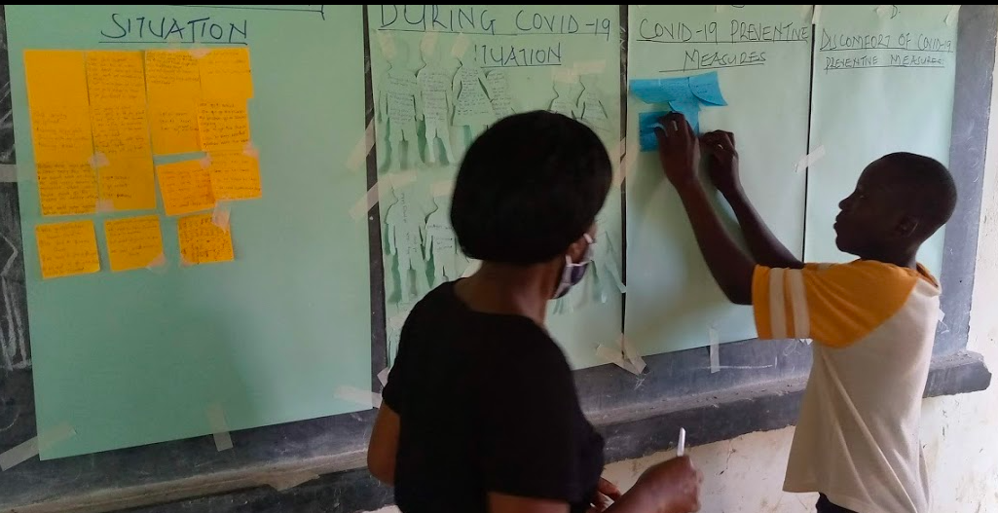
Children’s Voices
.

Slide 9
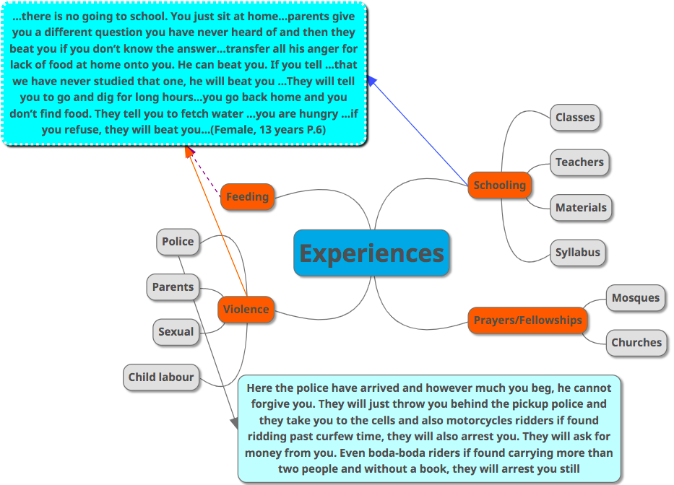
Qualitative results: Experiences

Slide 10
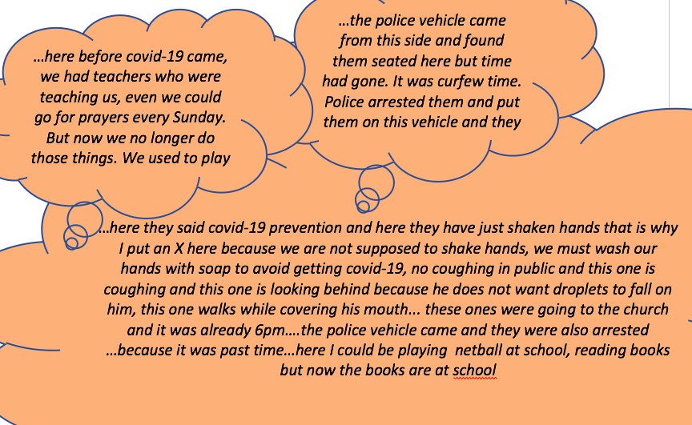
,

Slide 11
Qualitative Results: Perceptions

Slide 12
Observations/Discussion
Children are not as challenged much by adherence as they are by the inconvenience brought about by the observance/adherence
The more the children feel inconvenienced by the adherence to the preventive measures, the less they behave as expected.
Regardless of the gender of the pupil, their behaviour is equally affected the same way, during the Covid-19 preventive situation.
The contribution to the reported trauma signs are a big interplay of other factors at large (Contributing over 90%).
Although both girls and boys are affected differently, the effect on their trauma evidently weigh the same magnitude.

Slide 13
Conclusion
Covid-19 preventive measures were more traumatizing to school children much more than the virus itself.
Although children have been affected by the advent of Covid-19 and school closure, there are much more psychosocial and socioeconomic hinderances to their normal life, in the rural areas of Busoga.

Slide 14
Recommendations
As a public health concern, all the information on, and prevention of the spread of Covid-19 should be as inclusive and less abstract as possible.
Children, especially the school going should always receive guidance and counseling, in their communities and at all school centers, in order to reduce and/or avert the likely serious psychological effects: (like peritraumatic and pre-traumatic stress disorders, pathological aggression, multigenerational trauma challenges).

Slide 15
Acknowledgement
Children sharing their experiences
Research Assistants
Covid-19 Taskforce/office of the RDCs (Luuka, Mayuge and Kamuli)
The Government of Uganda, through the Makerere University Research and Innovations Fund

