Slide 1
The Erasmus Programme: from Europe to Africa
2018
University of Makerere, Kampala
University of Torino, Italy
Elana Ochse, University of Torino

Slide 3
Erasmus today: an opportunity to cross borders
Getting to know other peoples, languages & cultures
Studying abroad
Making new friends
Playing ambassador for your host country when you get back home

Slide 4
Desiderius Erasmus, a.k.a. ‘Erasmus of Rotterdam’ (1469 – 1536)

Slide 5
Erasmus
A Catholic priest: ordained to the priesthood in 1492
Started his studies at the University of Paris
The wandering scholar: Paris, England, Italy, Holland
Doctorate in Divinity from the University of Torino in 1506

Slide 6
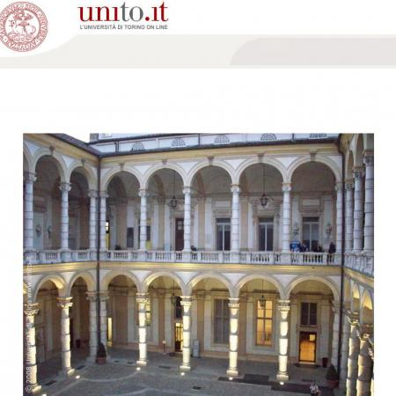
Main Building: University of Torino

Slide 7
Erasmus +

Slide 8
The Erasmus Project: Aims
Reduce unemployment
Promote adult learning
Encourage young people to take part in European democracy
Support innovation, cooperation and reform
Reduce early school-leaving
Promote mobility and cooperation with the EU’s partner countries

Slide 9
The Erasmus Student Exchange Programme
When? 30 years ago (1987)
Why? provide foreign exchange options for students from within the European Union
Who? Students and teaching staff from universities and seats of learning on the European continent.
How many? Over 4,000 individuals involved in the programme at any one time

Slide 10
New Erasmus +
Annual budget: 2 billion Euros per year
Duration: 2014 – 2020
Who can apply? Local and Regional authorities, Schools, Corporations, Training centres, Administrations, States, Universities, Non-profit organisations
Regions: European Union, Candidate countries, New Independent States, European Economic Area, Mediterranean countries, Switzerland, Worldwide, Balkans

Slide 11
Erasmus Partner Countries
Region 11 ACP = Africa, Caribbean and the Pacific
Angola, Antigua and Barbuda, Bahamas, Barbados, Belize, Benin, Botswana, Burkina Faso, Burundi, Cameroon, Cape Verde, Central African Republic, Chad, Comoros, Congo, Congo - Democratic Republic of the, Cook Islands, Djibouti, Dominica, Dominican Republic, Equatorial Guinea, Eritrea, Ethiopia, Fiji, Gabon, Gambia, Ghana, Grenada, Guinea, Guinea-Bissau, Guyana, Haiti, Republic of Côte d'Ivoire, Jamaica, Kenya, Kiribati, Lesotho, Liberia, Madagascar, Malawi, Mali, Marshall Islands, Mauritania, Mauritius, Micronesia- Federated States of, Mozambique, Namibia, Nauru, Niger, Nigeria, Niue, Palau, Papua New Guinea, Rwanda, Saint Kitts And Nevis, Saint Lucia, Saint Vincent And The Grenadines, Samoa, Sao Tome and Principe, Senegal, Seychelles, Sierra Leone, Solomon Islands, Somalia, South Sudan, Sudan, Suriname, Swaziland, Timor Leste - Democratic Republic of, Tanzania, Togo, Tonga, Trinidad and Tobago, Tuvalu, Uganda, Vanuatu, Zambia, Zimbabwe.

Slide 12
University of Torino + Makerere
2016-2018: Budget of almost 53,000 euros (to be used over a two-year period)
2017: Mobility of 4 students (2 x PhDs and 2x MAs) and two teaching staff members from Makerere University.
Mobility of two teaching staff members from the University of Torino. Both 2017 and 2018: Prof Cecilia Pennacini and Elana Ochse.
224 million Ugandan shillings

Slide 13
University of Torino + Makerere (2)
2018-2020: Budget of over 76,000 euros
Mobility from Makerere to Torino
5 students (PhD and Master’s)
1 non-teaching staff member (?)
2 teaching-staff members
Mobility from Torino to Makerere
1 non-teaching staff member
2 teaching-staff members
320 million Ugandan shillings

Slide 14
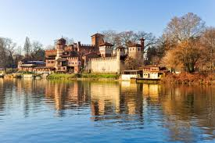
WELCOME to TORINO!

