Slide 1
Harnessing capacity for GLED course delivery
GLED review workshop for staff & resource persons
June 15, 2015, Metropole Hotel
Tabitha Mulyampiti

Slide 2
Introduction
GLED is a multi-discipline, multi-stake holder and multi-pronged policy concern
local economic governance
locality development
enterprise development
So?
The need to pump-up built-up experience for the next bold steps

Slide 3
Objectives
Lay out a plan for solidifying the successes
Develop a strategic direction for the next phase in LED implementation and re-focus objectives
Set out a plan for implementation & resource mobilisation
Assess internal readiness & engage & orient partners
Re-build, re-brand & harness energies & positive spirits to emphatically re-package the GLED course.

Slide 4
GLED over the years...lessons learned
Makerere—pillar of research excellence & innovations challenge
Re-alignment to national goals i.e. Vision 2040
Delivering course content Vs course management & development
Regular internal assessments & sharpening of the saw
GLED—an opportunity for outreach
Re brand! Rebrand! Rebrand!

Slide 5
Strategic direction
Short-term
Long-term
Strike a balance between two deeply inter-rated concepts of gender and LED
Retool, re-examine & address the bottle necks to effective course delivery
Support the National Gender Resource Team in their monitoring & advisory role
Build a data bank of institutional partnerships & resource persons
Course marketing & resource mobilisation
Become the centre of information/knowledge that is relevant to local economic conditions of Uganda
Build on models & theories that best inform the local practice
consider possibilities for a Masters in GLED
Policy & think tank—national & international engagement

Slide 6
Aligning GLED to national development goals
Revisit course objectives and content in view of the SDG and NDP goals and the Vision 2040.
Harness and enhance capacity for the existing skills and expertise
Bring on-board additional skill and expertise from the practitioners in both government and the private sector.

Slide 7
Strike the balance...
Stimulating productivity and reducing social-economic inequalities in communities by tapping into the resources and the ingenuity of the people
Current objectives:
Providing a clear understanding of gender focused concepts and tools that can be applied to planning, implementation and monitoring of policies and programmes in central and local government institutions as well as private sector.
Enabling students to learn and apply gender analytical tools in Local Economic development that supports strengthening of Local governance.
Enhancing the students analytical and practical skills in Gender mainstreaming in institutions, policies and programs
Enhancing capacity of development practitioners to learn and apply gender theory and analytical tools with-in their work, in skills training as well as in research that increases on availability of gender disaggregated data.

Slide 8
Redefine the target group
Assess readiness of providing wider scope
Develop & implement a strategy to secure students’ scholarships to enable them complete the course.
To re-package & market the course
Review of the current curriculum to suit a wider group.
Carryout pre-delivery assessments to determine peculiar needs & interests

Slide 9
Establish a GLED research base
Design & execute a research agenda
Using research to stimulate the generation of locally-grown conceptual and theoretical frameworks for analysing GLED;
Dissemination activities including scholarly and non-scholarly publications.
Think tank strategy

Slide 10
Invest in building managerial & administrative capacity
Assess managerial and administrative demands of delivering the course
Consider possibility for engaging non-academic professionals
Resourcing the administration department

Slide 11
Build capacity for M&E
Develop an M&E strategy and implementation plan;
Develop M & E tools for data collection & analysis
Orient staff towards the goals & objectives of M&E
Document experiences & lessons learned.

Slide 12
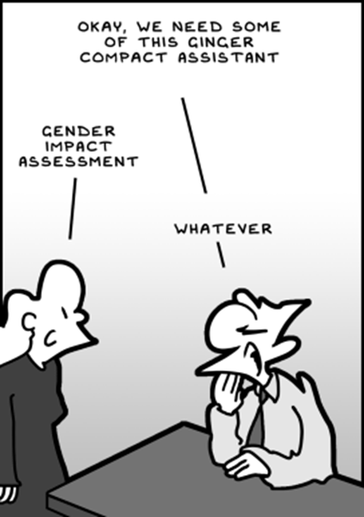

Slide 13
