Slide 1
CLIMATE-SMART PIGEON PEA FARMING FOR IMPROVED PARENTHOOD
POLICY BRIEF:
MARCH 2024
Howard Tugume
+256 706313063
htugume@gmail.com

Slide 2
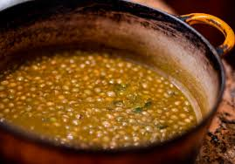
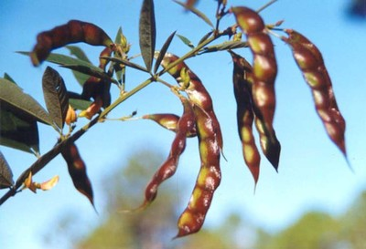
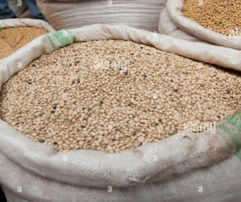
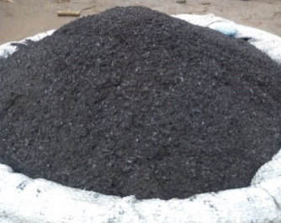
Introduction:
Pigeon peas are crucial for climate-smart agriculture, with multiple benefits:
Food
Income
Soil fertility
Farmers were committing more time to farming, affecting their roles as parents in ways that weren't studied

Slide 3
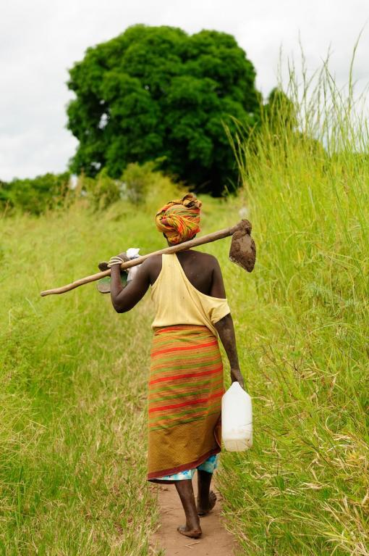
Research objectives
To validate parenthood among climate-smart pigeon pea farmers in Lira and Alebtong.
To analyze factors influencing parenthood among farmers in Lira and Alebtong.
To conduct a path analysis of time allocation between parenting and climate-smart pigeon pea farming.

Slide 4
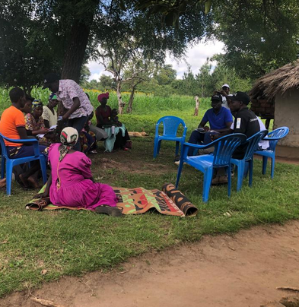
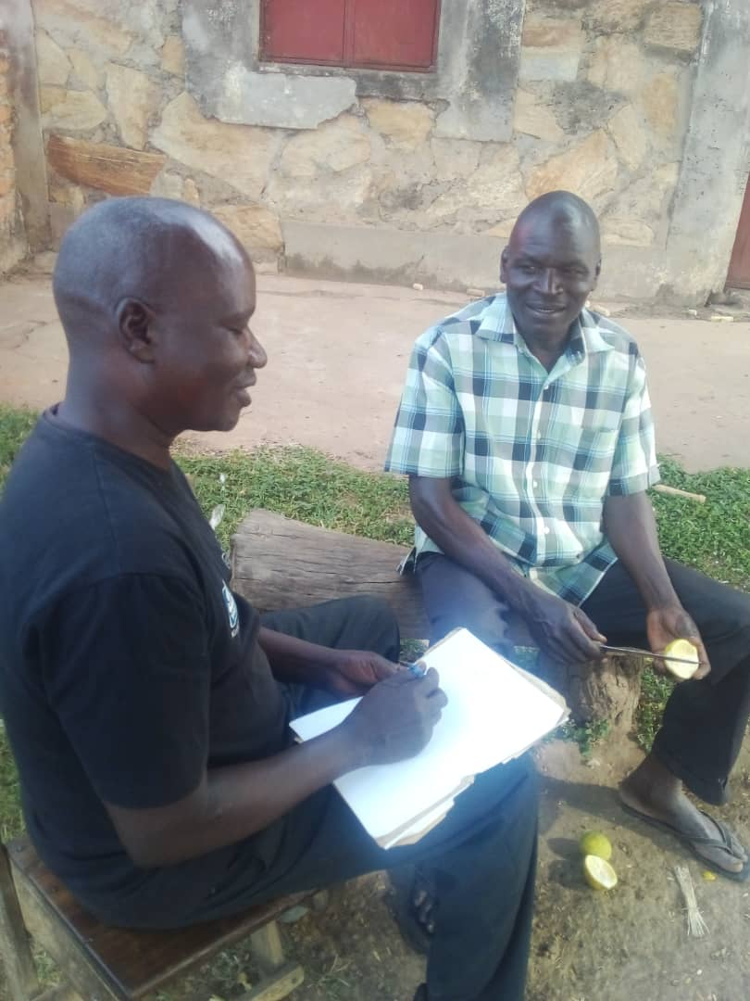
Methodology:
+
33 participants took part in focus group discussions
254 filled a survey questionnaire
Survey data was entered into spreadsheets and analyzed using Datatab software to generate descriptive reports with a 95% confidence level.

Slide 5
KEY FINDINGS
The core parenting roles were supporting education 76%, healthcare 60% and Child nurturing 49%
1
2
Gender Differences in Income, technology adoption, expenditure and parenting hours.
Indicator | Mothers (N=120) | Fathers (N=134)
Annual Income (“000”) | 1,800 | 2,500
Income from pigeon pea sales | 94 | 74
Number of CSA technologies | 1.6 | 1.8
Annual expenditure on a school child (‘000’, UGX) | 106 | 156
Annual hours spent on a school child | 769 | 554
Source: Survey data of 254 climate-smart pigeon pea farmers in Lira Alebtong
3
Increased CSA pigeon pea farming with not only enhances yields and soil fertility, but can potentially increase income for mothers.

Slide 6
Policy Implications:
The is need to:
1
Promote Climate-Smart Pigeon Pea farming
2
Facilitate Women's Access to Productive Resources
Reform land rights and ownership laws based on provisions in the National Land Policy.
Expand microfinance and Village Savings and Loans, take advantage of the PDM.
3
Shift Social Norms around Parenting Roles
Behavior change strategies geared towards supporting women in their parenting roles
Leverage Uganda's existing community-based early childhood care models
Engage Uganda's strong nonprofit/civil society sector in childcare provision.

Slide 7
Conclusion:
This study recommends deliberate actions to enhance parenthood for women as a way of supporting child nurturing, education and healthcare.
The study emphases climate-smart pigeon pea farming as a strategy to empower mothers to improve parenthood.
This can be implements alongside, strategies for empowering women to access resources and mindset changes with regard to parenting roles

Slide 8
FOR GOD AND MY COUNTRY,
THANK YOU ALL!
.

