Slide 1
Co-developing risk assessments in gene drive
By Prof. Charles B. Rwabukwali
Social Science Agenda for Gene Drive Research Workshop
19 May 2021, Kampala

Slide 2
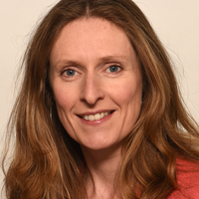
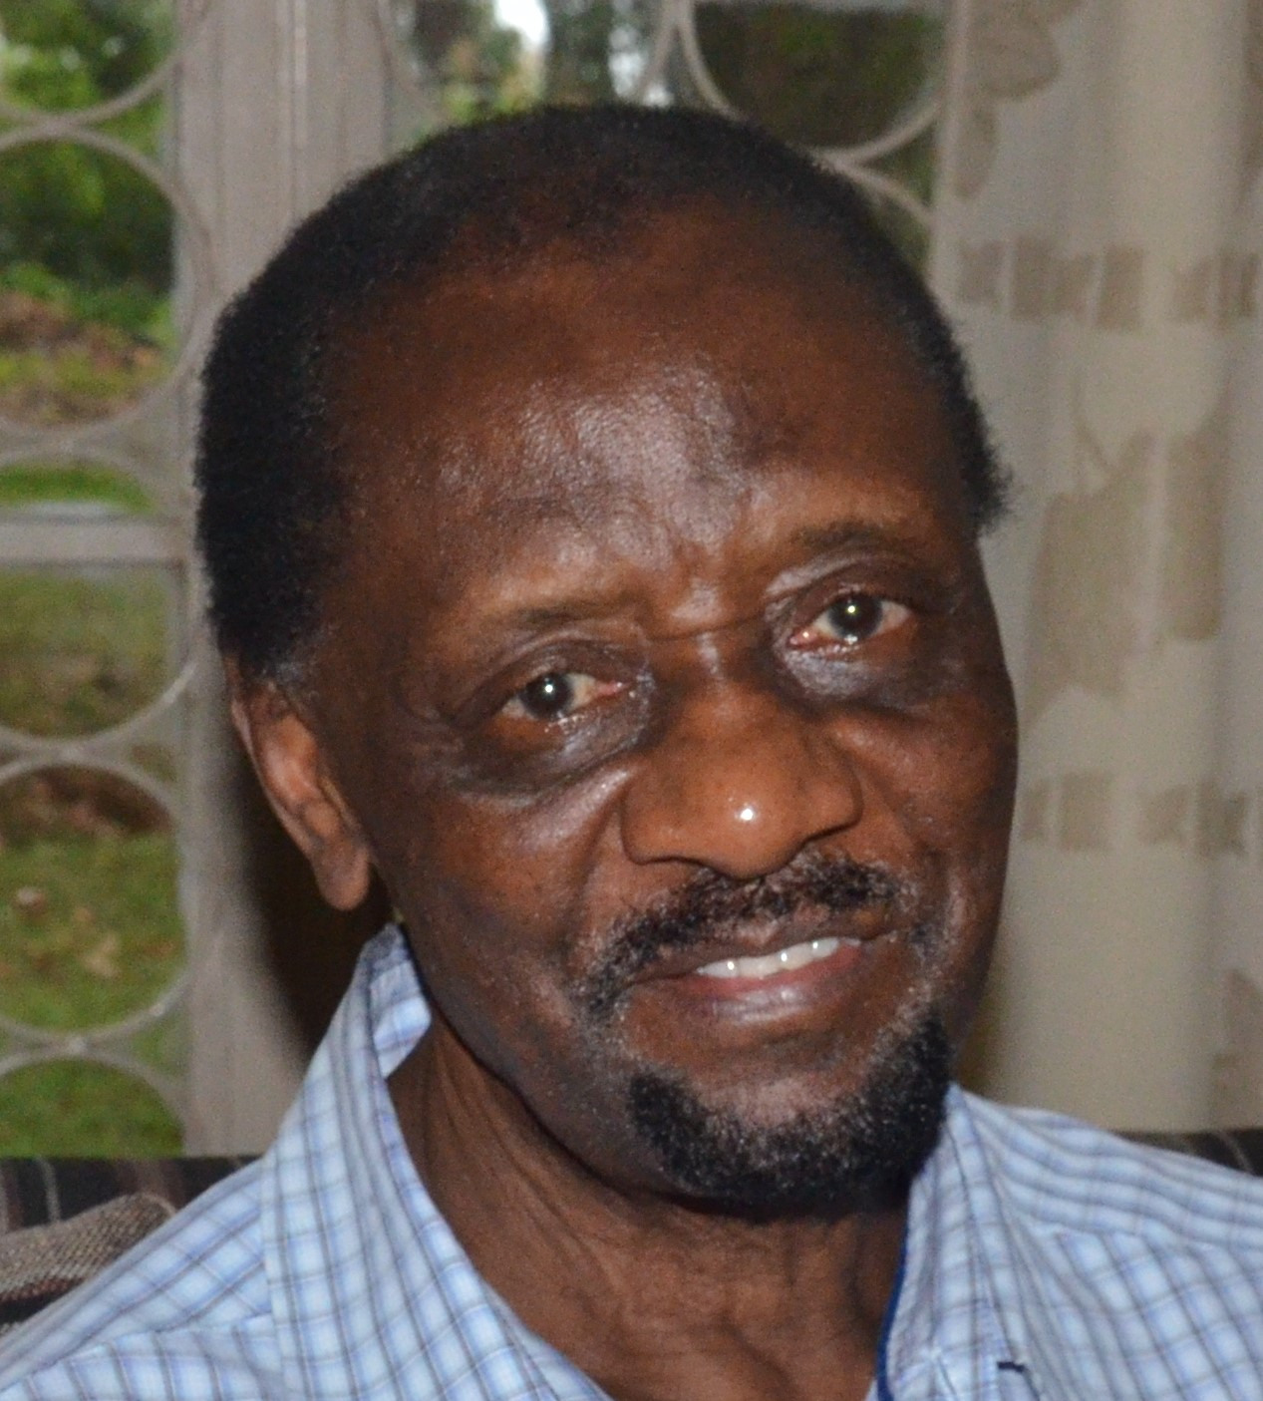
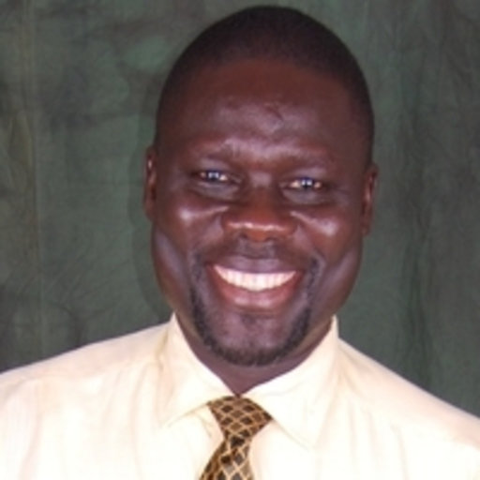
Project team
Principal Investigator
Sarah Hartley
University of Exeter
Ben Raymond
College of Life Sciences
University of Exeter
Co- Investigators
Charles B. Rwabukwali
Department of Sociology & Anthropology
Makerere University
Tibebu Habtewold
Department of Life Sciences
Imperial College London
Robert Smith
University of Edinburgh
Adam Kokotovich
Dept. of Forestry & Environmental Resources
North Carolina State University
George Ladaah Openjuru
Department of Education
Gulu University
Katie Ledingham
Department of Geography
University of Exeter

Slide 3
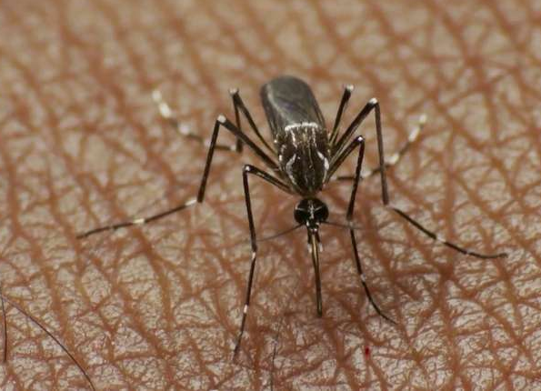
Introduction
Gene drive = cutting-edge technology involving spread of genetically modified genes in plant or animal populations
Being developed to eliminate malaria-carrying Anopheles gambiae mosquito to eradicate malaria
Has potential to protect endangered species and conserve nature
Increases frequency of desired gene into mosquito population through reproduction in small generations

Slide 4
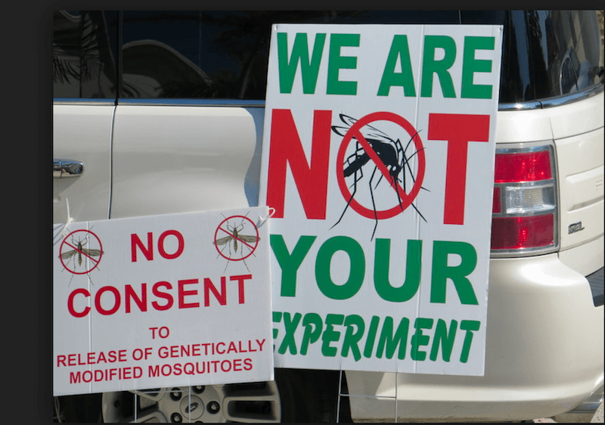
Gene drive technology in Uganda
Malaria is leading cause of morbidity and mortality in sub-Saharan Africa, Uganda inclusive
In 2019, WHO African Region was home to 94% of malaria cases and deaths
First candidates for adoption of gene drive to combat malaria will be in sub-Saharan Africa e.g. Mali and Burkina Faso
July 2019- Limited release of non gene drive genetically modified sterile mosquitoes in Burkina Faso
Riots and resistance to release of sterile genetically modified mosquitoes reported in Burkina Faso
Imminent challenges for use of gene drive in eradicating malaria
Notes:
.

Slide 5
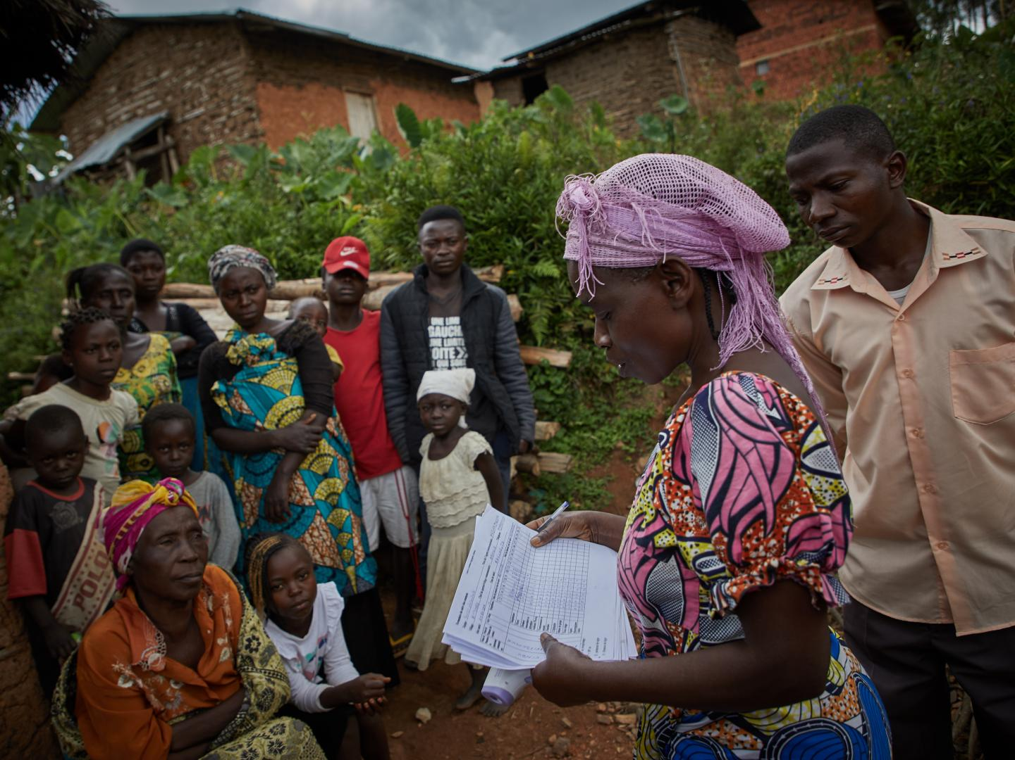
Requirements for gene drive
Gene drive is complex and requires collaborations across disciplines and borders
The technology requires establishment of risk assessment frameworks for potential harms and benefits
Surveillance and monitoring of post release behaviour and feedback from local communities and stakeholders is paramount
Public engagement, especially in developing risk frameworks on harms and benefits of gene drive

Slide 6
The Problem
“Scientists” most likely to influence traditional top-down approach to risk assessment for gene drive in developing countries like Uganda
To social scientists, this expert-led approach is narrow, linear, ignores the complexities of gene drive. We contest it.
The way forward: Open up the risk assessment process to a broader range of voices and consideration
Give opportunities to all categories of Ugandans to identify risks and benefits of gene drive that matter to them
Aim at inclusivity so that gene drive reflects diverse publics, including academia, civil society and lay actors
The real problem: There is little guidance surrounding who is to be involved in risk assessment, when to involve them and why. That’s the rationale for this study.

Slide 7
Objectives of our study
To understand the range of expertise required for risk assessment, who has such expertise and how can they best be engaged
Develop and test an empirical and theoretical grounded model for opening up risk assessment in interdisciplinary research
Explore the value of an experimental learning model using cases of gene drive risk assessment in other countries as bench marks

Slide 8
Theoretical framework
Based on theoretical concept of co-development
Co-development is promoted as a governance approach to interdisciplinary gene drive research
No one discipline has monopoly over all the answers
It is essential to have interdisciplinary teams that bridge natural and social sciences

Slide 9
Work plan
Documentary analysis of policy and regulatory documents, news articles, position papers to explore existing risk assessment work on gene drive, domestically and globally
Conduct semi-structured face-to-face interviews with selected Ugandan stakeholders e.g. public health officials, regulators, policy makers, community and civil society groups to explore range of risks/ impacts relevant to Ugandans.
Include persons working directly with gene drive, Ugandan scientists promoting gene drive Ugandan scientists opposed to gene drive, professionals living outside Uganda but write about gene drive developments in Uganda

Slide 10
The interview process
Examining international and national actors agitating for opening up gene drive risk assent and why
Identifying key actors shaping risk assessment in Uganda
Identifying risks/ impacts of gene drive presented in policy documents
Determining the most important risks/ impacts that stakeholders want included in risk assessment

Slide 11
The interview experience
We underestimated the amount of time it would take for conduct field work
Gene drive is controversial and many potential participants dodged us
Some assumed we were natural scientists trying to introduce gene drive in Uganda
Its an uphill task getting some people’s contact information e.g. phone, email address
Many participants did not want to be voice-recorded

Slide 12
Outputs
Three stakeholder workshops in Uganda, USA and the UK, to:
present project findings to stakeholders
Generate mutual learning (experimental learning)
Examine for scaling up our approach in gene drive research in other countries
Develop a larger grant proposal on gene drive, linking the UK, USA, Uganda, Burkina Faso and Mali
Prepare 2-page policy-relevant report to be disseminated to national and international stakeholders
Prepare academic papers

Slide 13
Key themes emerging from the data
Lack of awareness of gene drive
No clear distinction between GU and GD
A culture of mistrust and fear, especially regarding the motives of the global North
Issue of reversibility. How might a release of gene drive mosquitoes be undone or nullified if need be?

Slide 14
References
Benedict, M., Abbs, D., Dobson, S., Gottlieb, M., Higgs, S., et al. Guidance for contained field trials of vector mosquitoes engineered to contain a gene drive system: Recommendations of a scientific working group. Vector-borne and zoonotic diseases, 2008; 8 (2): 127 – 166.
Burt, A. and Crisanti, A., 2018. Gene drive: Evolved and synthetic. ACS Chem Biol 13 (2): 343 – 346
Hartley, S., Thizy, D., Ledingham, K., Coulibaly, A., Dicko, A., Dop, S., Kayondo, J., Namukwaya, A., Nourou, B., Toe Pare, 2019. Knowledge engagement in gene drive research for malaria control. PLOS Neg Trop D15 3 (14): 1-5
NASEM (National Academies of Science, Engineering and Medicine). Gene Drives on the Horizon. Advancing Research with Public Values, 2016. Washington DC: National Academies Press

Slide 15
Funding for this project is from the British Academy
Photo credits:
Unsplash
Genetic Literacy Project
North Carolina State University
Researchgate
University of Exeter

Slide 16
Thank You
Charles B. Rwabukwali
Charles.Rwabukwali@mak.ac.ug

