Slide 1
Key Human Resource Policies,responsibilities& Implimentation
Directorate of Human Resources By Deus Tayari Mujuni

Slide 2
Outline
Basic Definition
Human Resources policies Roles of the HR Directorate Roles of Line Managers Key Human Resource Matters & Responsibilities
Management

Slide 3
Some Roles of the Human Resources Directorate
Human Resource Management (HRM) refers to that part of an organization's activities designed to attract, train, develop and maintain an effective workforce
Some activities and roles undertaken include:
organizing the process of recruiting staff, organize training
conduct performance appraisal, planning future staffing requirements, handling grievances,
implementing HRM policy.

Slide 4
The Human Resources Manual (2009) as amended
The purpose of the Manual is to: Consolidates all Human Resource policies, procedures and practices in one document for ease of reference;
Defines the obligations and rights of the University Council as the Employer; Defines the obligations and rights of the employees of Makerere University; and, Serves as a reference framework for the Management of the Human Resources in the University.

Slide 5
The Human Resources Manual (2009) as amended
The purpose of the Manual is to:
Ensure compliance with employment legislations
Inform employees of our responsibilities & University’s expectation
Standard performance Employee motivation & Loyalty Resolving Conflict

Slide 6
HR Manual guides the entry, stay and exit of staff
Employment
Recruitment of staff
Promotions
Academic, Administrative and Support Promotions
Leave Management
Annual Leave, Sick Leave, Study Leave, Maternity Leave
Human Resource Development
Staff Trainings
Working
S^{H}tºa^{u}ff^{rs}Attendance, Work Load Vs Teaching Load
Exit Staff
Conduct of staff
Staff Appraoisals
Resignations, Dismisals, Retirements, etc

Slide 7
Key Human Resource Management Matters & Responsibilities
IMPLIMENTATION OF HUMAN RESOURCES MANUAL
The Directorate of HR, coordinates the overall implementation of the HR Manual. Oversees the activities of the key players in the implementation of the HR policies.
Line Managers ensure adherence to the provisions of the HR manual and other policies.(section1.8(d)

Slide 8
Recruitment of staff
Appointments
on (Probation) Six Months-Confirmation
Contractual appointments- Months apply for renewal Temporary/Administrative Appointments (Contractual Appointments)
Responsibilities
Line managers to identify the critical capacity gaps based on structure, wage vacancy and work load,
Declare the vacancies timely to the directorate of HR
Temporary/Administrative appointments. Section 2.2.2k of the HR manual provides for short term contractual appointments authorised by the Vice Chancellor.
Pursuant to section 50(3) of the University and Other Tertiary Institutions Act,2001 (as amended), the Appointments Board will therefore be required to ratify all University staff appointments made under Section 2.2.29k) of the HR manual.
Line managers MUST follow the approved guidelines for appointment of staff on short term contracts in the University service July 2023

Slide 9
Staffing Status
Academics
filled at 39.4% Average age 48.9 yrs
Administrative
filled at 36.22% Average Age 46.5 yrs
Support
filled at 39.33% Average Age 49.6 yrs
60 % female and 40% male

Slide 10
Part-time and Short-term Contract staff paid from College/Unit Non Wage Budgets
During its special meeting held on 9th may 2024, the University Council noted the existence of considerable wage expenditure at the Unit/College level primarily related to part time or short term contract staff appointments.
Council noted that the practice strains non wage funds intended for critical functions including teaching and research materials and other recurrent costs.
The University Council resolved effective FY 2024/2025 there shall be no staff appointments or salary payments at any Unit level. All salaries will be accommodated within the appropriated wage budget.

Slide 11
Part-time and Short-term Contract staff paid from College/Unit Non Wage Budgets
All University Officers are prohibited from assigning work to individuals without valid contract with the University. Any Officer who assigns work to an individual without a valid contact approved and issued by the University, shall be personably liable for misconduct and the resulting wage or other obligations- Refer Mak/US/406 2021 dated 1st July 2021 to College Principals and Heads of Administrative Units.
STUDY LEAVE- Section 5.1.6 of the HR Manual as amended
Study leave shall mean the period a member of staff is away from official work for a formal training or Post Doctoral Research.
Salient issues.

Slide 12
Line Managers
Responsibilities of Line Managers
Consider the eligibility of the applicant Consider the procedure as laid out in the HR Manual 5.1.6 (2) (a-t)
Key to note
Leave approval by the VC Duly signed bonding forms
Quarterly reports by the student Reporting back at the end of study leave.
The HoD MUST report whether the Officer has reported or not.
Observation. Staff not returning after study leave.

Slide 13
Other Leaves 5.1 of the HR manual
Leave is the official time a member of staff is off duty from the University.
No staff shall leave the official work of the University without official permission.
Conditions governing different types of leave
The line managers must report when the officer reports back on duty after the end of leave
Develop a robust leave roster
Any staff who fails to return from leave amounts to misconduct section 9.6 (p) of the HR manual.

Slide 14
Payroll Management
All staff shall receive the compensation as provided in the salary schedule for the salary range for the position in which they are employed.
All staff are entitled to monthly salary as long as the are working or on official leave.
Line managers responsibilities
To report staff who are not working and keep drawing salary
In line with 668th meeting on 14th October 2021, the University Appointments Board directed that College Principals and Head of Administrative Units must submit duly signed monthly schedules of the staff in post and staff on official leave to the Directorate of Human resources copy to the University Secretary.
Observations. Delays in submission as well as not being honest to the directive.

Slide 15
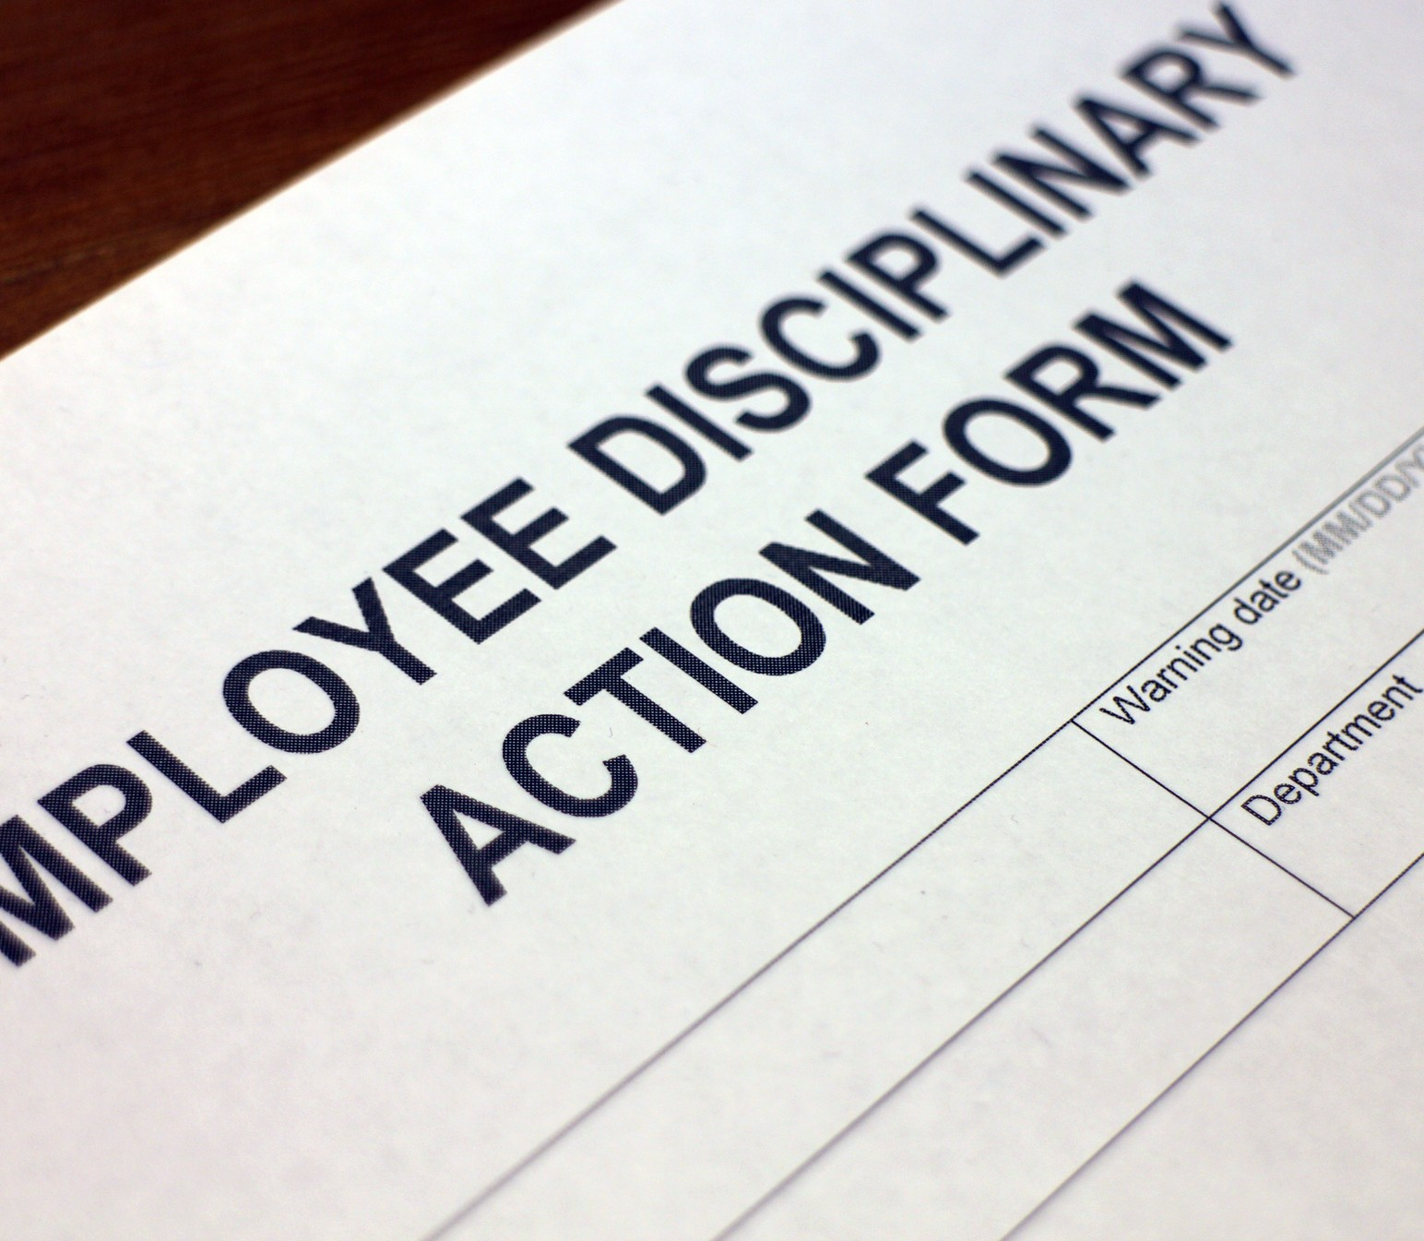
Disciplinary offences/Misconduct
An employee shall act at all times in a reasonable & responsible manner Comply with the laws of Uganda as well as University’s prescribed policies, procedures etc
Section 9.6 (a-r) of the HR Manual highlights the offices that may be construed as gross misconduct

Slide 16
Disciplinary Measures
Corrective Counselling Written reprimand Warning,
Suspension, Reduction in rank, termination & Dismissal

Slide 17
Performance Management & Human Resource Devt
Performance Management is a systematic process of managing the organization and its human resources to achieve a high and steady rate of performance. It comprises a set of procedures used to plan, direct and improve the performance of members of staff in accordance with achieving the overall strategic objectives of the organization.
Rationale
To drive the University to become a high-performance focused Organisation; To align individual members of staff objectives with the University's objectives and core values;
Responsibilities of Line Managers

Slide 18
Performance management cycle
This entails a lay out of management activities executed with in the specified months of a performance year. For example

Slide 19
Employee Safety
The University is committedto promoting and achieving a highstandard of staff safety and health.
The University adheres to the principle that occupational safetyand health of members of Staff is a priority at the workplace.
All UniversityStaff shall be accorded a safeand secure working environment in accordance with Occupational Health and Safety Act 2006 (as maybe amended).
It is the obligation of the University to comply with provisionsof the Occupational, Health and Safety Act.

Slide 20
Employee Safety
Obligations of the University
Safe working environment
Ways to reduce hazards and risks of health
Training on employee safety
Systems of work, plant and machinery are safe
Competent supervision
Obligations of Employee
Take maximum precaution, Comply with H&S regulations, Report unsafe situations, report incidents that result into injury

Slide 21
Employee Safety
Compensation.
Employers is compensation
liable ifaccident
to paying arises out of
employee course of work To and from place of work
In case of total incapacitation or death – lamp sum payment

Slide 22
Line Managers
The Line Managers are responsible for managing employees to ensure successful
execution strategies.
Under
of organizational goals and
score the role of each Line
manager- distinct
Appreciate the contribution of each Line Managers.
Avoid conflict.

Slide 23
Makerere University
Thank You
Deus Tayari Mujuni

