Slide 1
The Theory and philosophy of graduate supervision: Reflections on supervision styles
Betty Ezati

Slide 2
Introduction
Supervision
Supervisors personal and professional experiences impact and shape supervisory relationships.
Should you impose your values on students?
A demanding practices that is hardly standardized
Supervision style is known during supervision
Supervision mainly one to one relationship
Approaches
Approaches used relies on supervisors’ capabilities derived from experiences and personality (Amundsen and McAlpine, 2009; Bøgelund, 2015)
Relationship
Defined by the learning role of PhD candidates and the teaching role of professors.

Slide 3
What is supervision?
A formal process based on the relationship between supervisor and supervisee (candidate), where the supervisor’s role is to help the supervisee acquire appropriate professional behaviour and competence in professional activities (Loganbill & Hardy (1983)
Is discipline and oversight of work (Lee, 2009)
Is a two-way interactional process that requires the student and the supervisor to connect intentionally with each other and within the spirit of professionalism, respect, collegiality, and open-mindedness (Ismail, Abiddin & Hassan, 2011).
How do you perceive supervision?

Slide 4
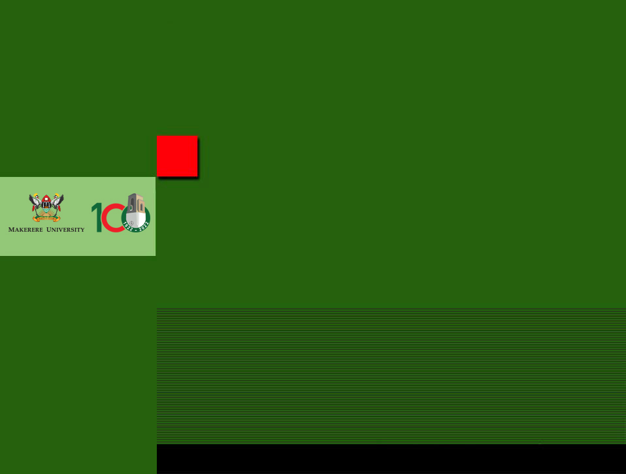
Supervision styles

Slide 5
Some theoretical perspectives
1
2
3
Classical academic
Supervision as an issue of teaching
Psychological
Supervision as an issue of individual talent
Socialisation
Creating a working environment of togetherness
4
5
6
Master—Apprentice
Learning as ‘best practice’, copying and ‘role modelling’
Peer to Peer
Collegial and mutual learning
Neoliberal
Focus on quality, publications, citations and time frames

Slide 6
Psychological
Supervision is a question of talent or ‘style’
Supervisors prefer to ‘learn’
more about themselves
models and techniques
how to conduct supervision
to be able to stimulate the PhD student

Slide 7
Supervision as an issue of socialisation
Collective research culture
stimulates ability to cooperate
Includes necessity for social integration
favours those whose values ​are consistent with the dominant paradigm in the group
regular meetings
encouraging collaboration instead of competition
the PhD students writing together

Slide 8
Master-Apprenticeship model
Learning by best practice (’Community of Practice’)
developing skills, values
education towards independence
Critics
Tendency of unreflective imitation
unequal relation
works best with supervisor and students of similar background variables (Lee & Williams, 1999)
’master – slave’ (Grant, 2008)
It’s a hierarchical relationship that provides an unidirectional mode of knowledge transfer from the powerful supervisors to powerless supervisees.

Slide 9
Peer to peer
Peer to Peer model
Dynamic situation of negotiations about the research process than the production of research
Mutual learning processes
PhD students and supervisors learn from one another
PhD students and supervisors work/conduct research together

Slide 10
Neoliberal
Efficiency, quality, evaluation, follow-up routines
Market driven
the production of PhDs (quantitative aspect)
to publish (quantitative aspect) prestigious Journals (qualitative aspect)
to recruit capable students timely completions
apply for and get research funding
appear as excellent (individual/environment) defined by other actors/institutions
constructing oneself by participating in conferences, lists of publications, websites
to become recruited as a supervisor for further career steps

Slide 11
Supportive Vs Directive (Gu, etal 2017)
01
04
Personal support, (caring for wellbeing, fostering friendship, emotional, boosting confidence)
Learner centered (Discovery – dialogue and inquiry)
05
02
Purpose is to develop individual potential
Promote deep learning
Academic support (availability,
provision of timely feedback))
03
06
Autonomy support (recognizing student’s viewpoint, encouraging them to express their thoughts openly, and giving them the opportunity to make their own decisions)
task-oriented aiming at providing framework for decision-making and action that is in line with the supervisor’s vision (Somech, 2016)

Slide 12
Another way of viewing styles
Expert guide
01
06
Quality controller
02
Delegator
Friend
05
Co-writer
03
04
Coach

Slide 13
Dynamics of supervision style
Start:
If there is no prior contact often starts in a business like fashion, directed at process
Data collection
By the time of data collection (in case of frequent contact of joint lab work/field work), a more personal style develops (if things don’t go wrong).
After the fieldwork
Style of supervision often shifts back to a more businesslike approach, guiding the PhD candidate in the appropriate data analysis

Slide 14
Dynamics of supervision style
Thesis writing:
Relationship becomes more personal again, gradually shifting from a process approach to product supervision
Final write up:
As one approaches accepting the PhD manuscript, the relationship has to become more formal again, culminating in the official defence ceremony
After the formal defence
A more personal style, and the relationship often shifts back from product to a joint process of getting journal articles accepted, or of making policy briefs, conferences papers.
If the process goes well, a good personal relationship remains, and the supervisory task shifts to career advice.

Slide 15
Concluding remarks (Tian & Singhasiri, 2016; Waghid, 2015),
Supervisor is the closest person who can mentor and provide the support and guidance to the student
Supervision is a personal journey of discovery. A relational and empowering process
supervision is pedagogically a complex activity that is getting more controlled (regulations) (McGloin, 2018; Olmos-López & Sunderland 2017).
Supervision is a mixed of roles and practices. You never use one style

Slide 16
The student-supervisor relationship is embodied in power dynamics, and its complex nature is influenced by various socio-economic factors such as culture, gender, ethnicity, expertise, age and race (Green & Dekkers, 2010).
Note

Slide 17
What supervision style would you use?

Slide 18
THANK YOU FOR LISTENING

