Slide 1
The Erasmus Programme: from Europe to Africa
2017
University of Makerere, Kampala
University of Torino, Italy
Elana Ochse, University of Torino

Slide 3
Introduction
Erasmus today

Slide 4
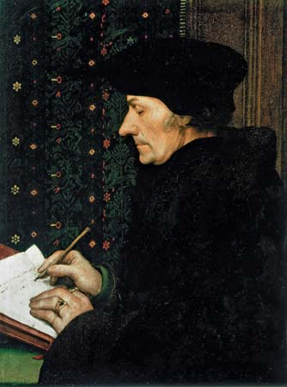
Desiderius Erasmus, a.k.a. ‘Erasmus of Rotterdam’ (1469 – 1536)

Slide 5
Erasmus
A Catholic priest: ordained to the priesthood in April 1492
Started his studies at the University of Paris
The wandering scholar: Paris, England, Italy, Holland
Doctorate in Divinity from the University of Torino in 1506

Slide 6
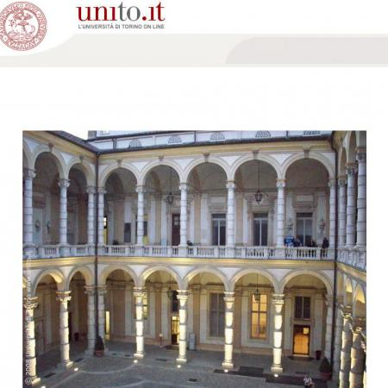
Main Building: University of Torino

Slide 7
Erasmus (2)
Enormous faith in the power of education.
With strenuous effort human nature could be molded, so as to draw out peaceful and social dispositions while discouraging unworthy appetites.
In brief, Erasmus believed that one is what one reads.

Slide 8
Erasmus (3)
Encyclopaedia Britannica:
Erasmus was: a humanist who was
the greatest scholar of the northern Renaissance,
the first editor of the New Testament
an important figure in the study of classical literature.
A precursor to the Lutheran Reformation and the Catholic Counter-Reformation
In brief, a scholar with an independent stance in an age of fierce confessional controversy

Slide 9
Erasmus +

Slide 10
The Erasmus Project: Aims
Reduce unemployment, especially among young people
Promote adult learning, especially in the new skills
Encourage young people to take part in European democracy
Support innovation, cooperation and reform
Reduce early school-leaving
Promote mobility and cooperation with the EU’s partner countries

Slide 11
The Erasmus Student Exchange Programme
When? 30 years ago (1987)
Why? provide foreign exchange options for students from within the European Union
Who? Students and teaching staff from universities and seats of learning on the European continent.
How many? Over 4000 individuals involved in the programme at any one time

Slide 12
New Erasmus +
Annual budget: 2 billion Euros per year
Duration: 2014 – 2020
Who can apply? Local and Regional authorities, Schools, Corporations, Training centres, Administrations, States, Universities, Non-profit organisations
Regions: European Union, Candidate countries, New Independent States, European Economic Area, Mediterranean countries, Switzerland, Worldwide, Balkans

Slide 13
Erasmus Partner Countries
Region 11 ACP = Africa, Caribbean and the Pacific
Angola, Antigua and Barbuda, Bahamas, Barbados, Belize, Benin, Botswana, Burkina Faso, Burundi, Cameroon, Cape Verde, Central African Republic, Chad, Comoros, Congo, Congo - Democratic Republic of the, Cook Islands, Djibouti, Dominica, Dominican Republic, Equatorial Guinea, Eritrea, Ethiopia, Fiji, Gabon, Gambia, Ghana, Grenada, Guinea, Guinea-Bissau, Guyana, Haiti, Republic of Côte d'Ivoire, Jamaica, Kenya, Kiribati, Lesotho, Liberia, Madagascar, Malawi, Mali, Marshall Islands, Mauritania, Mauritius, Micronesia- Federated States of, Mozambique, Namibia, Nauru, Niger, Nigeria, Niue, Palau, Papua New Guinea, Rwanda, Saint Kitts And Nevis, Saint Lucia, Saint Vincent And The Grenadines, Samoa, Sao Tome and Principe, Senegal, Seychelles, Sierra Leone, Solomon Islands, Somalia, South Sudan, Sudan, Suriname, Swaziland, Timor Leste - Democratic Republic of, Tanzania, Togo, Tonga, Trinidad and Tobago, Tuvalu, Uganda, Vanuatu, Zambia, Zimbabwe.

Slide 14
University of Torino + Makerere
2016-2018: Budget of almost 53,000 euros (to be used over a two-year period)
Mobility of 4 students (2 x PhDs and 2x MAs) and two teaching staff members from Makerere University.
Mobility of two teaching staff members from the University of Torino. This year Prof Cecilia Pennacini and Elana Ochse.
224 million Ugandan shillings

Slide 15
Other UniTO exchange projects
TeachMob, organised by UniTo with the aid of a national banking group (1)
WWS (Worldwide Style), also organised by Unito (2)
Dr Godfrey Asiimwe (2016) African History and Development
Anthony Mugeere and Netsanet Gebremichael (2015): doctoral students

Slide 16
University of Torino + Makerere (2)
2018-2020: Budget of over 76,000 euros
Mobility from Makerere to Torino
5 students (PhD and Master’s)
1 non-teaching staff member
2 teaching-staff member
Mobility from Torino to Makerere
1 non-teaching staff member
2 teaching-staff members
320 million Ugandan shillings

Slide 17
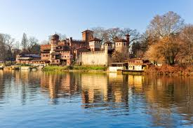
WELCOME to TORINO!

